Slide 1
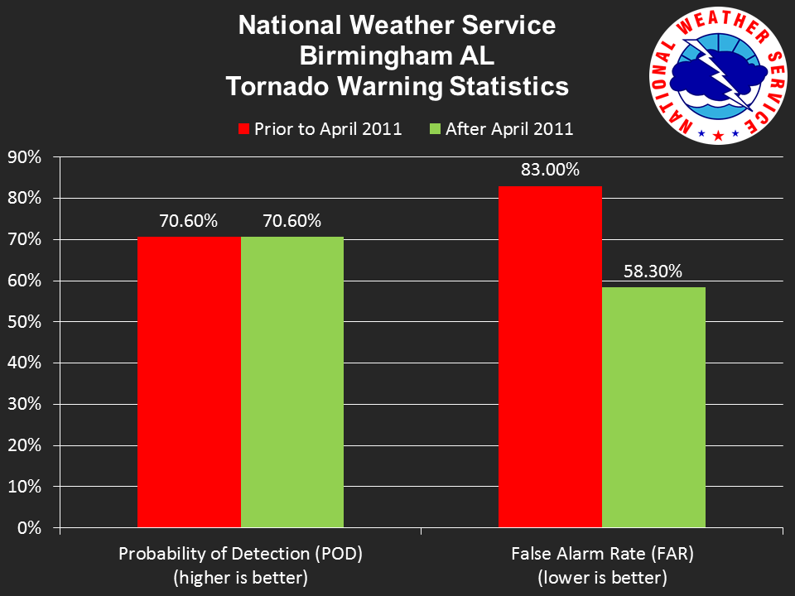
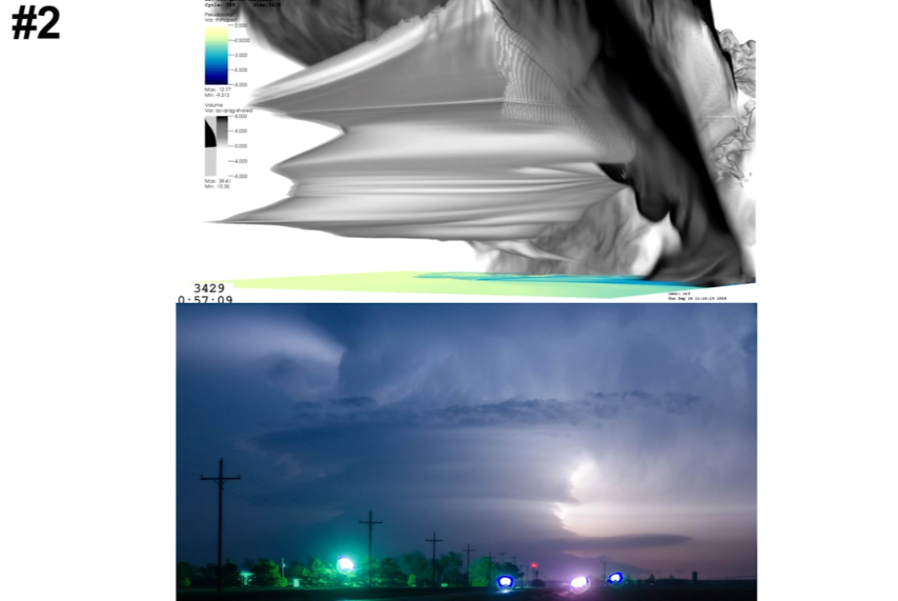
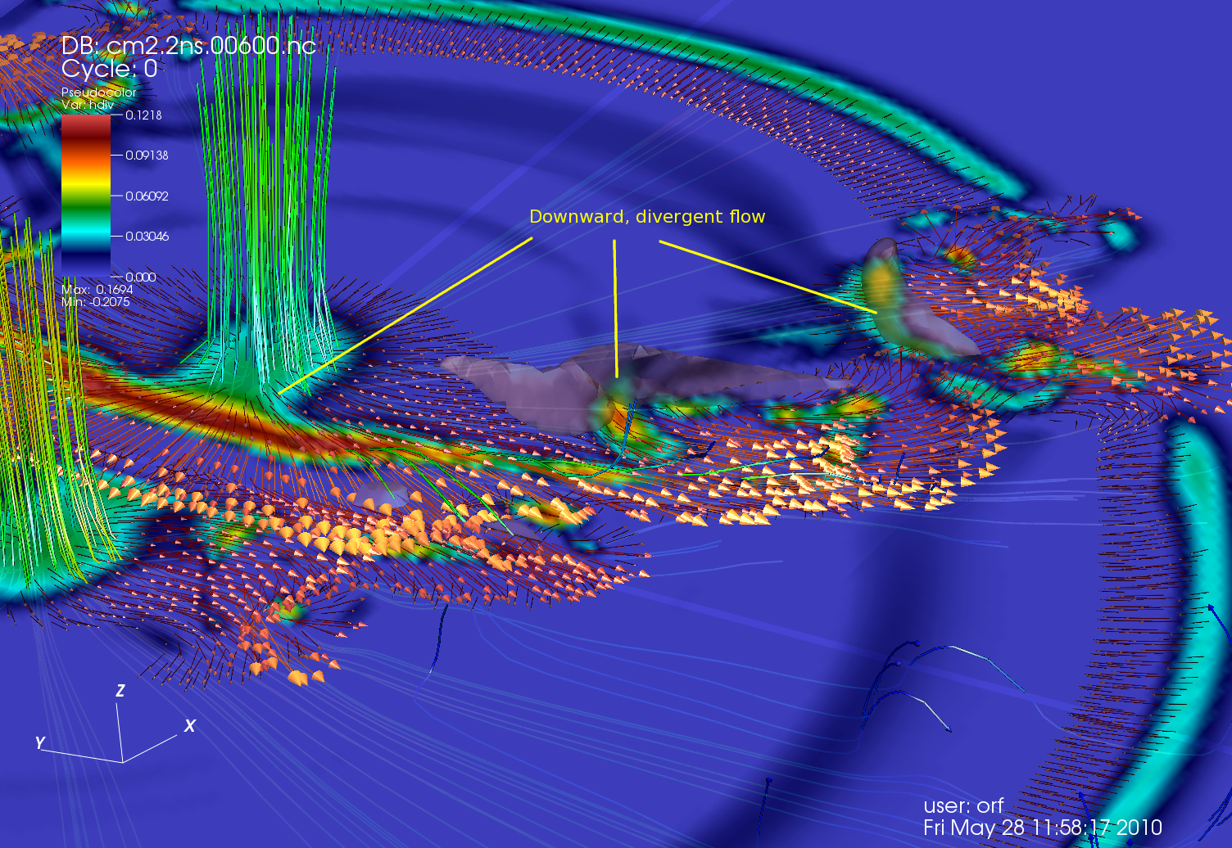
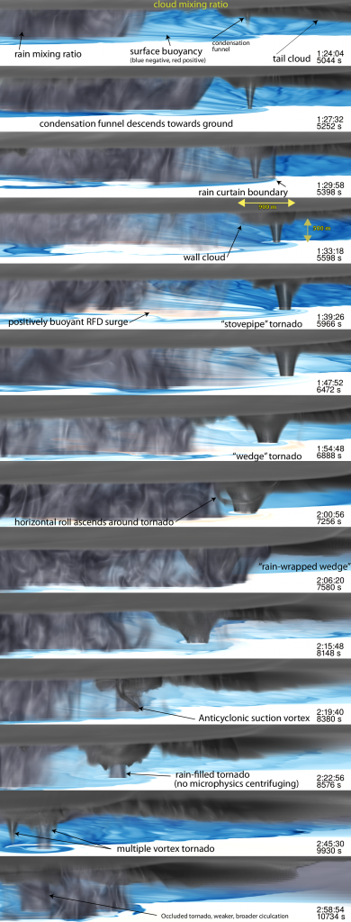
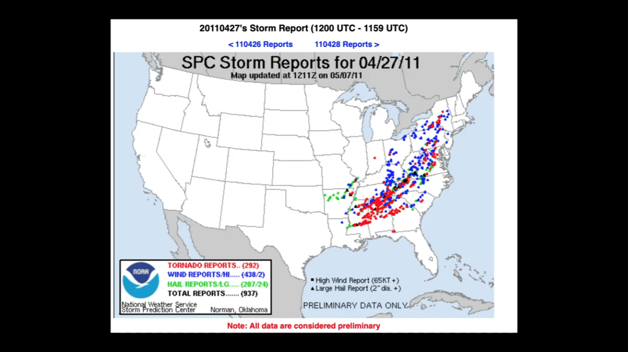
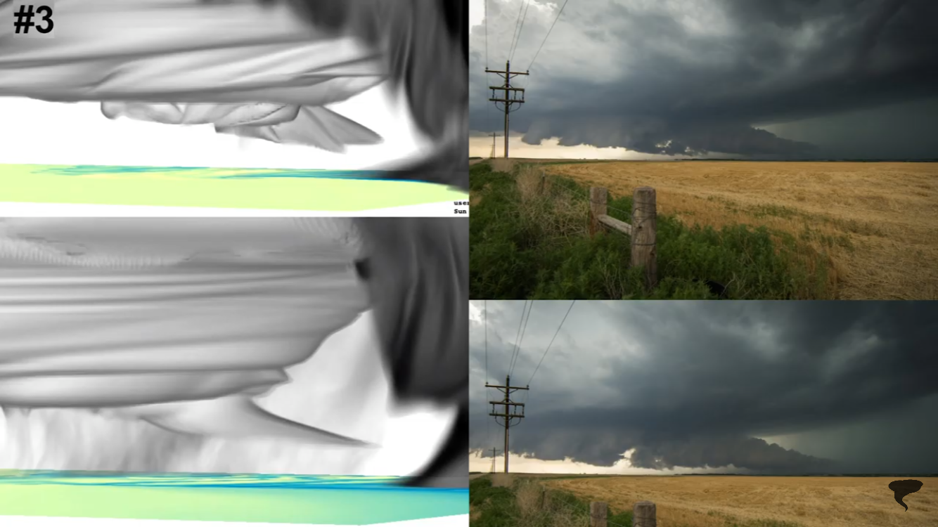
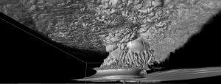
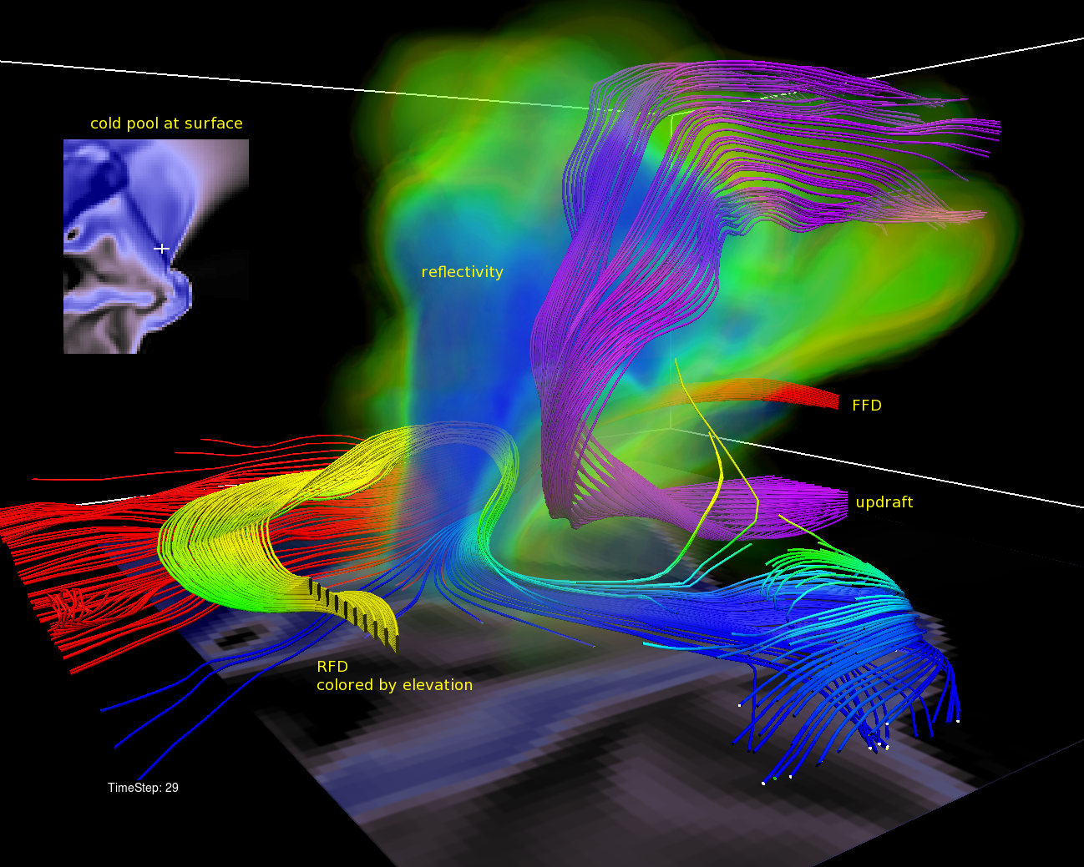
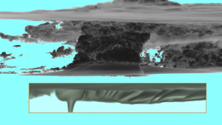
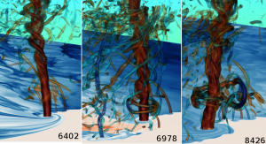
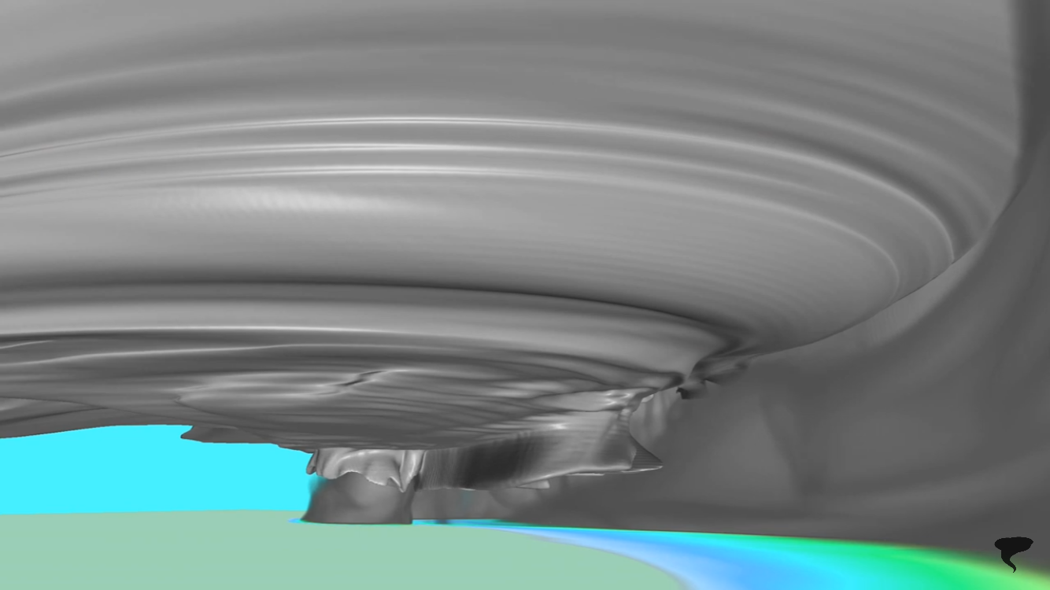
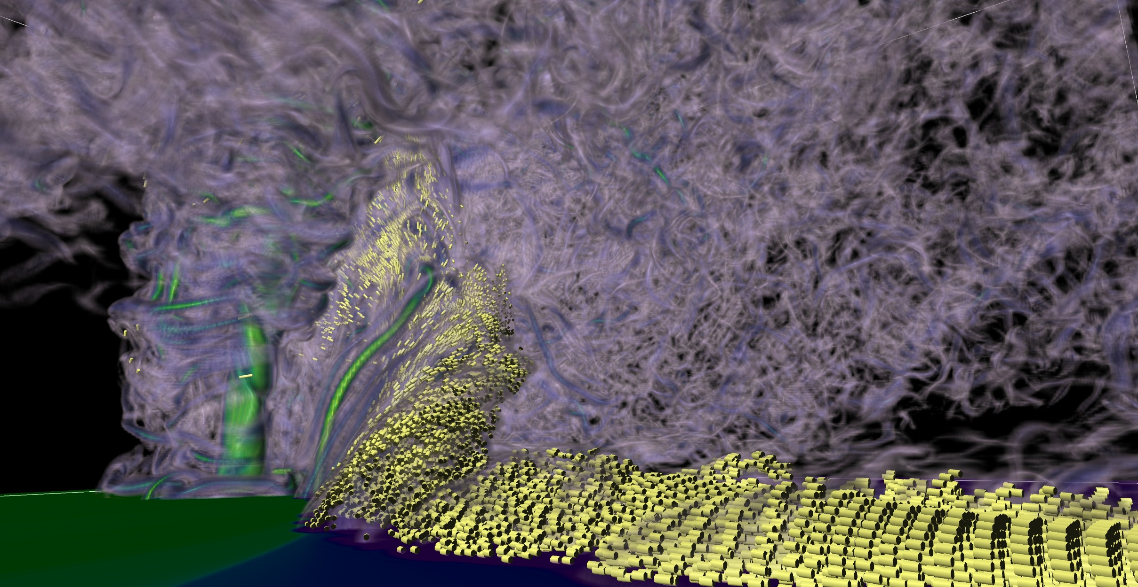
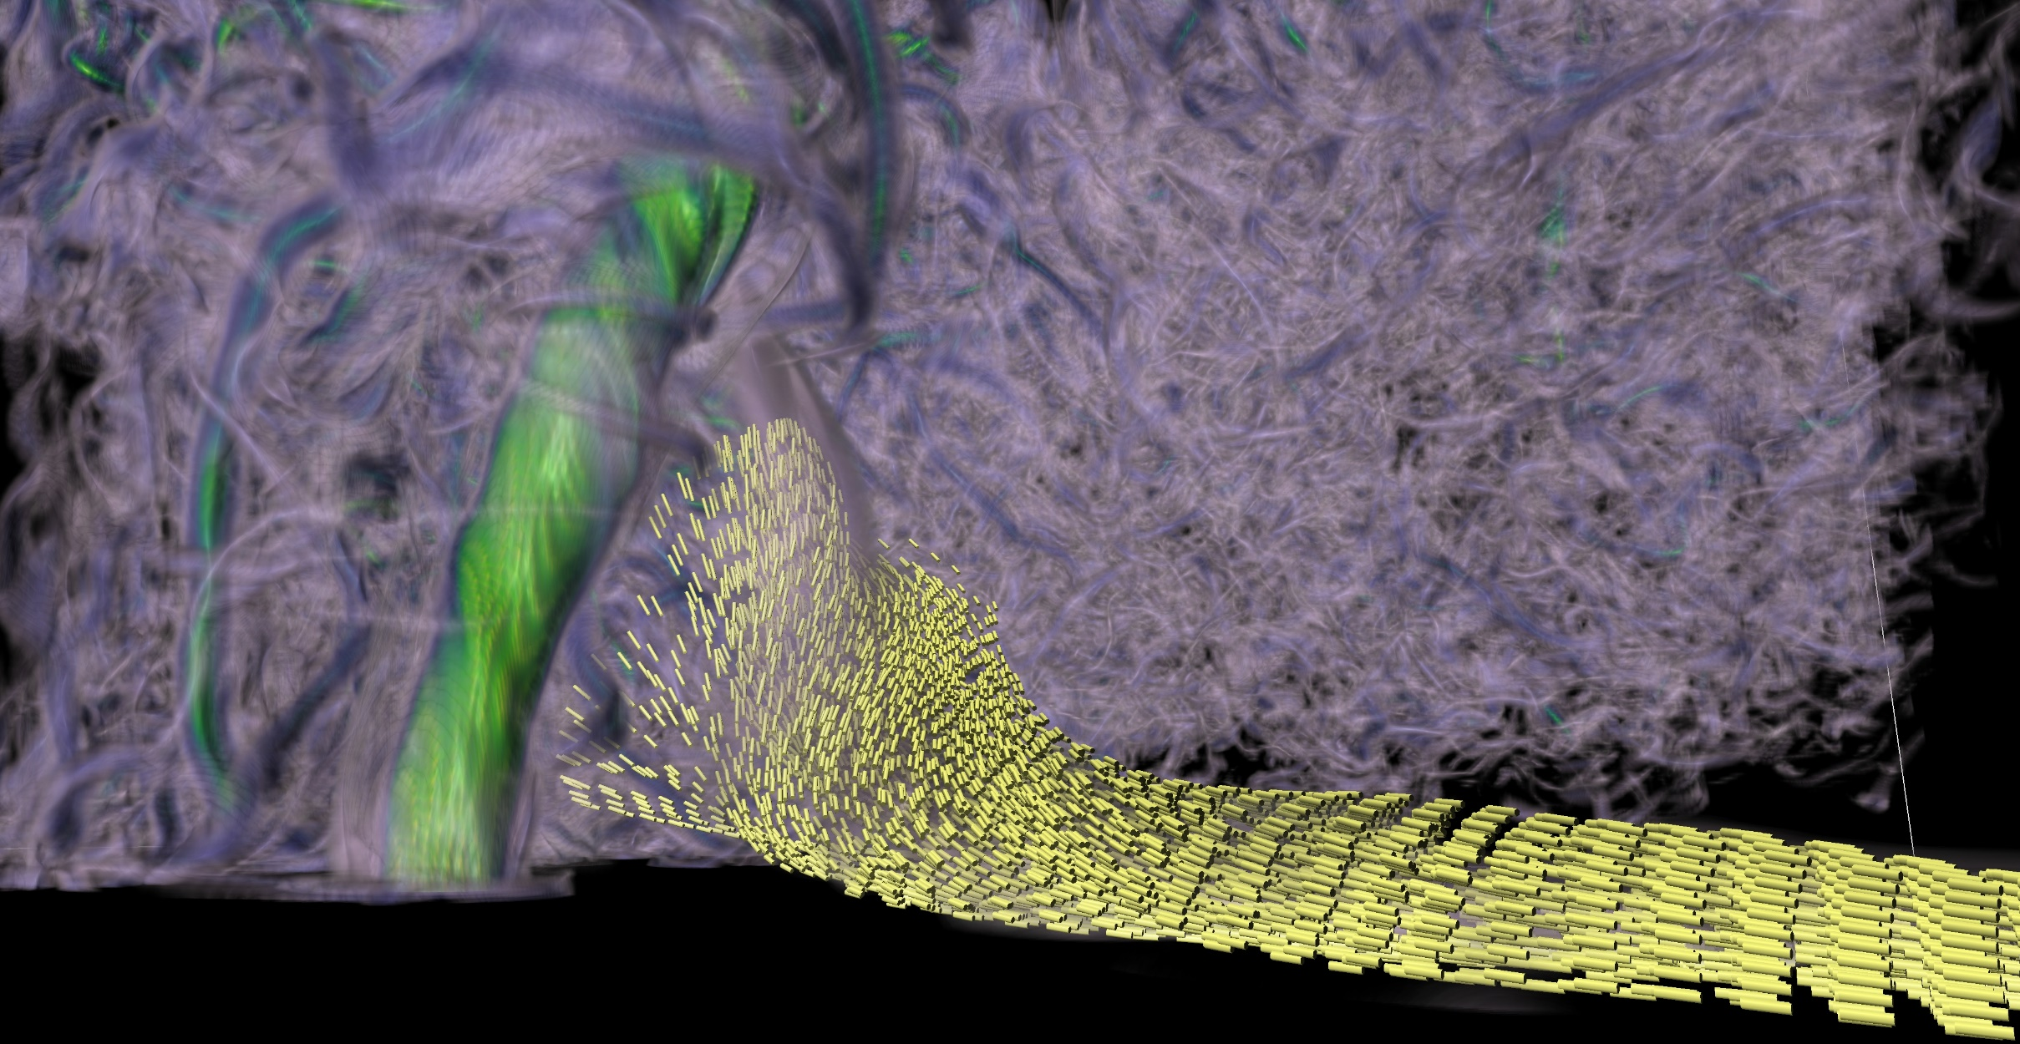
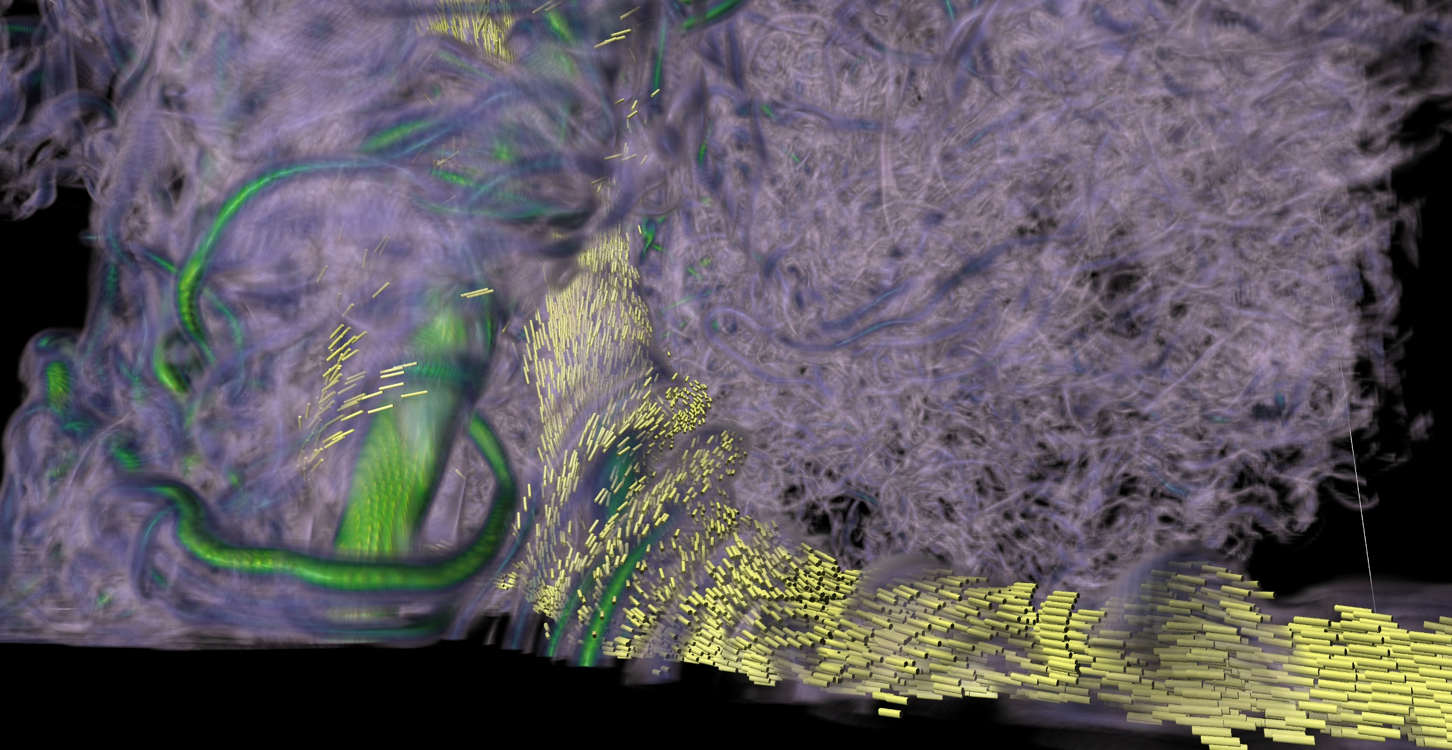
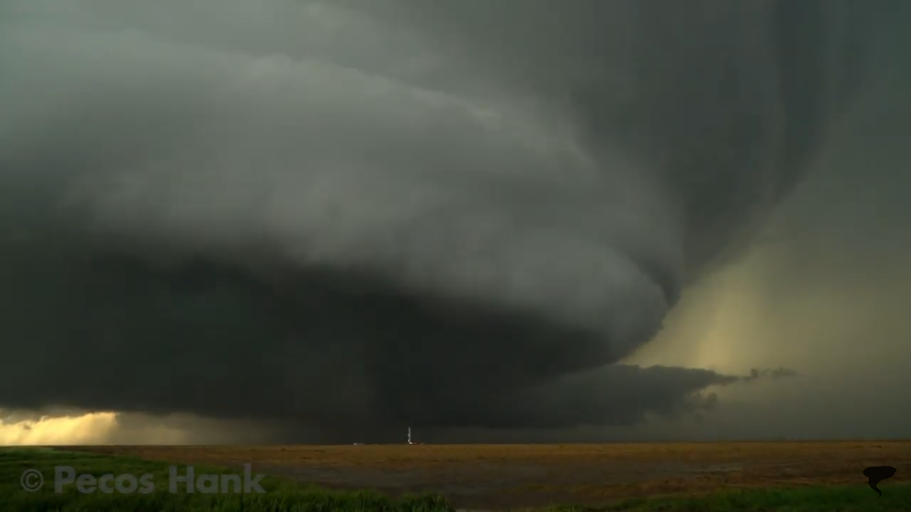
Investigating The Impact Of Tornado Modeling On Casualties Miriam Roman Robert M. La Follette High School
Introduction
False alarms from the National Weather Service creates a loss of credibility. This increases the number of casualties when a supercell becomes a tornado and people choose to ignore the alarms sent out by the National Weather Service. Tornado modeling can be used to gain a deeper understanding of past storms by creating a model from data of historical storms. Based on the results from research done by the National Weather Service, the false alarm rate has gone down by 24.7% since May 2014. This decrease in the false alarm rate is the result of tornado warning verification statistics.
By using tornado modeling combined with the verification statistics, the National Weather Service would be able to decrease the false alarm rate.
Hypothesis
If tornado modeling and tornado warning verification statistics were to be combined, the data would become more accurate and create the ability for the models to predict future storms.
Research Procedure
Tornado warning verification would continue to analyze data, in order to see the decrease of the false alarms. The use of the Bluewater supercomputer located in the University of Illinois, would be used to create newer models based on recent data. These models would be used to analyze major factors of storms such as updrafts, horizontal and vertical vorticity, air pressure and the mesocyclone.
Results
Through this research there has been new evidence that previous theories such as the need for a rear flank downdraft to maintain a storm, were in fact incorrect. New discoveries found via tornado models, have shown that the updrafts of a tornado can be very strong , within a close proximity to the ground. The strength and range of the updrafts produce stronger stretching. The storm takes the horizontal vorticity and collects in the center before tilting the horizontal vorticity, converting it into vertical vorticity. This is important because the vertical vorticity contributes into the mesocyclone and possibly the rotation of the tornado itself.
Summary
Tornado modeling has already disproven some major theories and helped deepen the understanding of tornadoes. This technology is continuing to advance and with new data, the models can become more accurate, potentially predicting future storms and ultimately saving lives.

